Slide 1
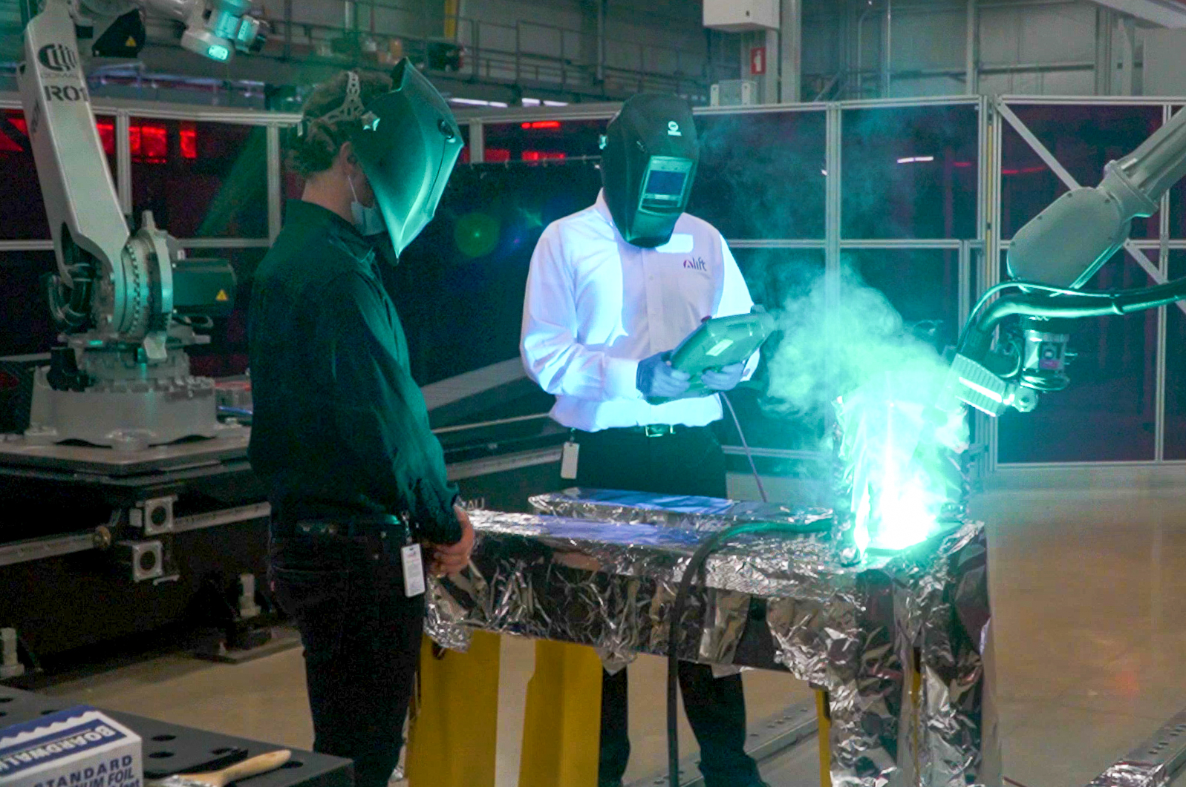




Driving American
Advanced Manufacturing Into the Future
Advancing ICME for U.S. Casting & Forging Industries
A Department of War National Asset

Slide 2
Project Call: Advancing ICME for U.S. Casting & Forging Industries
Date:
Proposer Organization:
Proposal Name:

Slide 3
Proposal #:
LIFT ICME for Casting & Forging
Project #:
Instructions
Complete the attached forms to submit your project:
There are multiple topic areas proposers may submit against (see previous slides)
Include proposed budget (Maximum $450,000 from LIFT) and timeline
Projects will be evaluated on:
  Technological Merit
  Technology MRL/TRL Level
  Program Timing
  Funding Requirement
  T&Cs Agreement
  MII Member Engagement
  Cost Share Commitment (cost share = minimum 25% of the total project value is required (CS = LIFT funding/3))
Submit completed forms to https://lift.technology/project-calls/
Participants must have a U.S.-based division and all individuals working on the project must be U.S. persons

Slide 4
Proposal #:
LIFT ICME for Casting & Forging
Project #:
Project Data
Submission Date:
Industry:
Proposal Number:
Proprietary?
Accept T&Cs?
Company:
LIFT Member?
Member Level
Title:
Goal:
Project Leader:
Leader Email:
Leader Phone:

Slide 5
Proposal #:
LIFT ICME for Casting & Forging
Project #:
Partners and Key Personnel
List all partners that will participate including suppliers and academic institutes
  Indicate subcontract Principle Investigator (only one PI allowed)
  % responsibility for each partner
  Provide principle contact for each partner
Approval
COO: Noel Mack
CFO: Victor Claudio
CEO & Executive Director: Nigel Francis

Slide 6
Proposal #:
LIFT ICME for Casting & Forging
Project #:
Abstract
Summary overview of the proposed project

Slide 7
Proposal #:
LIFT ICME for Casting & Forging
Project #:
Proposed Budget
Workshare and Funding breakdown of project:
  Note: Though not necessary, LIFT Engineering Services are available to support subcontractors upon request for quote
Project Funding
Project Funding from LIFT
Member Cost Share (CS $)
Total Project Value (TPV $) | $xxx,xxx
% Cost Share (=100%*[CS/TPV] ≥ TPV/3) | xx%
Organization | Member Level | Cost $’s | Cost %
Organization Name A
Organization Name B
Organization Name C
Organization Name D
LIFT Engineering Services | LIFT
Total Project Value (TPV $) |  | $xxx,xxx | 100%
Estimated Total Project Value: (TPV $) Estimated Total Cost Share: (CS $)

Slide 8

Proposal #:
LIFT ICME for Casting & Forging
Project #:
Identification of the Problem
      Give background that identifies the problem
Deliverables
      Deliverables shall define the key performance indicators that will be used to:
      Judge the success of the deliverables
      Identify ways to improve performance at a later date

Slide 9
Proposal #:
LIFT ICME for Casting & Forging
Project #:
Proposed Work Justification
      Does the proposed work benefit a single company, or will it offer improved techniques or technology to American companies?
      Is patentable IP anticipated? Will background IP be disclosed to LIFT during the project?
      What gives the proposed work novel attributes and/or significant alignment with the selected topic?
      Include as appropriate:
      Theory
      Relevant previous experimental results
      Theoretical modeling of experimental results
      Implications of work completed to date
      Identification of critical needs
Add additional citations, photos and/or pages as needed

Slide 10
Proposal #:
LIFT ICME for Casting & Forging
Project #:
Current and Future Technical Status
      Define the current TRL and MRL Level of your technical solution (See Appendix)
      Define and explain expected TRL and MRL of your technical solution at the conclusion of the project

Slide 11
Proposal #:
LIFT ICME for Casting & Forging
Project #:
Problem Scope
      Define and explain the proposed effort’s scope, as well as what activities are out of scope

Slide 12
Proposal #:
LIFT ICME for Casting & Forging
Project #:
Technical Approach/ Solution
      State the proposed solution
      List clear, specific tasks
      Include Graphs, photos, examples, etc.

Slide 13
Proposal #:
LIFT ICME for Casting & Forging
Project #:
Project Schedule
      High level Gantt showing tasks and dependencies
Example TimeLine
Month 1
Month 2
Month 3
Month 4
Month 5
Month 6
Design/Simulation
Simulation
Design Proto Tools
Build Proto Tools
Assembly/Try
Testing /Validation

Slide 14
Proposal #:
LIFT ICME for Casting & Forging
Project #:
Proposed Work at LIFT and Anticipated Environmental Impact
For project work planned at LIFT, identify:
      Potential adverse environmental impacts from the completion of this work
      Hazardous chemicals or other materials
      Provide SDS sheets for proposed chemicals and materials brought into LIFT
      Possible emissions of toxic substances due to the operation of a process
      If there are no adverse impacts show this page as “N/A”

Slide 15


Thank You
LIFT
@NewsFromLIFT
1400 Rosa Parks Blvd. Detroit, Michigan 48216
(313) 309-9003
@NewsFromLIFT
@NewsFromLIFT
communications@almmii.org
www.lift.technology
LIFT | The National Advanced Materials and Manufacturing Innovation Institute
15 | LIFT BUSINESS SENSITIVE

