Slide 1
LIFT Ecosystem Accelerator Program (LEAP 2022)
Project Submission Form
Rev. 2
DEV 3/10/2022

Slide 2
Instructions
Complete the attached forms to submit your project
Include proposed budget ( Maximum $100,000 from LIFT ) and timeline ( 6 months )
Projects will be evaluated on:
Technological Merit
Technology MRL level
Program Timing
Funding Requirement
LIFT Member Engagement
Planned use of LIFT’s High-Bay Equipment.
Cost Share Commitment
Submit completed forms https://lift.technology/project-calls/

Slide 3
Project Data
Submission Date:
Industry:
Proposal Number:
Proprietary?
Member Level
Company:
LIFT Member?
Title:
Goal:
Project Leader:
Leader Email:
Leader Phone:

Slide 4
Partners and Key Personnel
List all partners that will participate including Suppliers and Academic Institutes
Indicate Principle Investigator (only one PI allowed)
% responsibility for each partner
Provide principle contact for each partner
Approval
CTO: Noel Mack
CFO: Victor Claudio
CEO & Executive Director: Nigel Francis

Slide 5
Abstract
Summary overview of the proposed project

Slide 6
Proposed Budget
Workshare and Funding breakdown of project
Organization | Member | % Effort | Cost $’s | Cost %
Organization Name A (PI) | Platinum
Organization Name B | Gold
Organization Name C | Silver
Organization Name D | Bronze
Organization Name E | Academic
LIFT High-Bay | LIFT
Total Project Value (TPV $) |  | 100% | $xxx,xxx | 100%
Project Funding
LEAP Project Funding from LIFT
Member Cost Share (CS $)
Total Project Value (TPV $) | $xxx,xxx
Estimated Total Project Value: (TPV $) Estimated Total Cost Share: (CS $)

Slide 7
Identification of the Problem
Give background that identifies the problem
Deliverables
Define the measures or other indicators that will be used to:
Judge the success of the deliverables
Identify ways to improve performance at a later date

Slide 8
Proposed Work Justification
Does the proposed work benefit a single company or will it offer improved techniques or technology to American companies? Explain
Is patentable IP anticipated? Will background IP be disclosed to LIFT during the project?
What gives the proposed work novel attributes?
Include as appropriate:
Theory
Relevant previous experimental results
Theoretical modeling of experimental results
Implications of work completed to date
Identification of critical needs
Add additional citations, photos and/or pages as needed

Slide 9
Current and Future Technical State
Define current TRL/MRL Level (See Appendix A)
Define and explain TRL/MRL at conclusion of project

Slide 10
Problem Scope
State what will be within the team’s working boundaries and what the team will not be working on.

Slide 11
Technical Approach/Solution
State the proposed solution
List specific tasks
Include Graphs, photos, examples, etc.

Slide 12
Project Schedule
High level Gantt chart showing tasks & dependencies
Suggested TimeLine
Month 1
Month 2
Month 3
Month 4
Month 5
Month 6
Design/Simulation
Simulation
Design Proto Tools
Build Proto Tools
Assembly/Try
Testing /Validation

Slide 13
Proposed Work at LIFT and Anticipated Environmental Impact ​
For project work planned at LIFT:
Identify potential adverse environmental impacts from the completion of this work
The use of hazardous chemicals or other materials.
Provide SDS sheets for proposed chemicals and materials brought into LIFT
Possible emissions of toxic substances due to the operation of a process
If there are no adverse impacts show this page as “N/A”

Slide 14
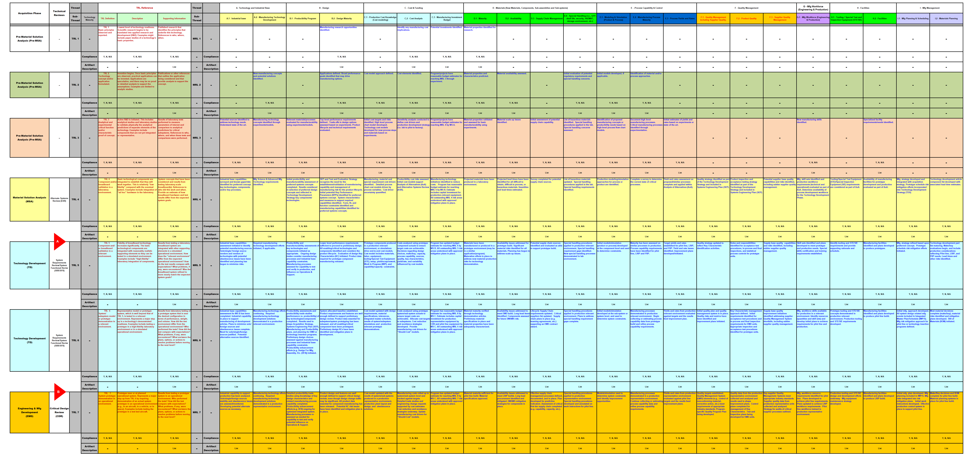
Current Technical State
Appendix A

Slide 15
THANK YOU!
Follow us on LinkedIn at LIFT
LIFT:
(313) 309-9003
communications@almmii.org
www.lift.technology
Follow us on Twitter @NewsFromLIFT

