Slide 1
Hypersonic Thermal Research & Material Acceleration Project Submission Forms
Rev. 3
ASH 10/19/2021

Slide 2
Hypersonic Project Instructions
Instructions
Complete the attached forms to submit your project. Feel free to add extra slides as needed to fully respond to the Request for White Paper.
Include proposed budget, timing plan, and resource plan
Projects will be evaluated on:
Technical ability to support the request
Ability to meet program timing & proposed budget including cost share
LIFT Member Engagement
Responding to this request for white paper for services does not require the provider to be able to support the entire request. Should there be aspects that cannot be supported, simply note those on the white paper.
There is no limit to the number of white papers that can be submitted by a single entity
Submit completed forms at https://lift.technology/project-calls/
LIFT membership not required for white paper submission but is required for receipt of funds

Slide 3
Paper #:
Hypersonic
Project #:
Project Data
Submission Date:
Industry:
Paper Number:
Proprietary?
Member Level
Company:
LIFT Member?
Title:
Goal:
Project Leader:
Leader Email:
Project Scope:
[Metallic/Ceramic/Both?]
Leader Phone:

Slide 4
Paper #:
Hypersonic
Project #:
Partners and Key Personnel
List all partners that will participate including suppliers, Small Medium Enterprises (SME’s), Academic Institutes
Estimate % responsibility for each partner
Provide principle contact for each partner
Indicate partner LIFT membership status
Approval
VP of Tech: Noel Mack
CTO: Hadrian Rori

Slide 5
Paper #:
Hypersonic
Project #:
Abstract
Summary overview of the proposed scope of work
Budget Overview
Estimated Total Project Value: (TPV $) Estimated Total Cost Share: (CS $)

Slide 6
Paper #:
Hypersonic
Project #:
Problem Scope
State what will be within the team’s working boundaries and what the team will not be working on.

Slide 7
Paper #:
Hypersonic
Project #:
Technical Ability to Support the Request
State the technical capabilities to complete the scope of work
List specific skillsets, modeling, equipment, resources, etc.
Include Graphs, photos, examples, etc.
What makes your proposed approach novel?
IP generation anticipated? Will background IP be shared with LIFT during the project?
Include as many slides as needed to address this topic.

Slide 8
Paper #:
Hypersonic
Project #:
Technical Ability to Support the Request
Include as many slides as needed to address this topic.

Slide 9
Paper #:
Hypersonic
Project #:
Deliverables & Project Schedule
High level Gantt chart showing tasks & dependencies
Define the measures or other indicators that will be used to:
Judge the success of the deliverables
Identify ways to improve performance at a later date

Slide 10
Paper #:
Hypersonic
Project #:
Budget
Note: If you are an academic member, cost share is one of the decision criteria (minimum 25% of sponsored funding)
Budget breakdown must include details of the cost share.

Slide 11
Paper #:
Hypersonic
Project #:
Anticipated Environmental Impact of Planned Work
For project work planned at LIFT:
Identify potential adverse environmental impacts from the completion of this work
The use of hazardous chemicals or other materials.
Provide SDS sheets for proposed chemicals and materials brought into LIFT
Possible emissions of toxic substances due to the operation of a process
If there are no adverse impacts show this page as “N/A”

Slide 12
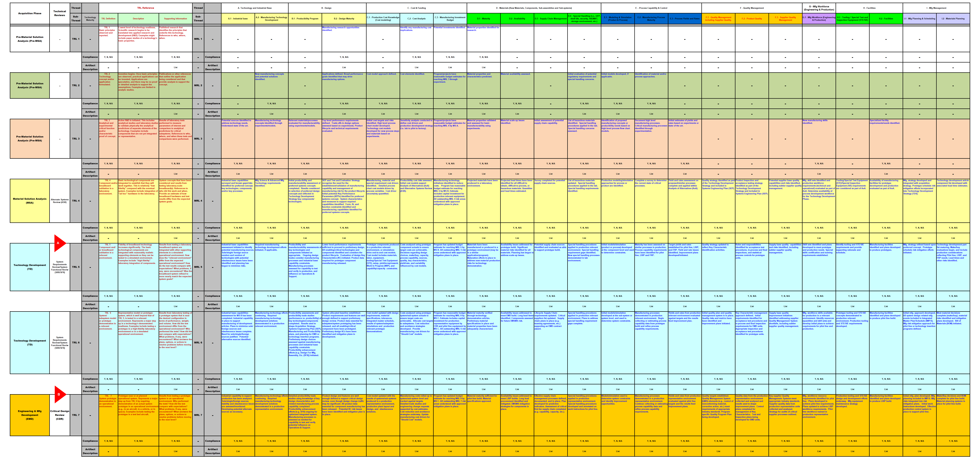
Paper #:
Hypersonic
Project #:
Current Technical State
Appendix A

