Slide 1
LIFT Hypersonic Challenge
April 19, 2021
Rev. 8

Slide 2
Hypersonics Challenge
Project Summary
Open to all LIFT members
Awardee must be a LIFT Silver member or higher tier
All project consortium members must be a LIFT member in good standing for award
Non-members and/or lower tier members may submit proposals but must join membership or upgrade membership as appropriate
Challenge participants must be ITAR compliant
Subject(s) are defined by three (3) challenge briefings
Hypersonics Modeling & Simulation (ICME)
Advanced Manufacturing Methods for Quality and Production
Advanced Manufacturing for High Temperature Composites
Consortiums must be led by one organization (Principal Investigator)
Max $1.0M LIFT challenge contribution per project
No mandated cost-share
Cost-share (recommended at 1:1) is strongly considered in project selection
Twelve (12) month project duration
Max fifteen (15) months with reporting
LIFT Business Sensitive

Slide 3
Hypersonics Challenge
Project Timing
Project Call: April 19, 2021
Proposal Deadline: July 2, 2021
Project Announcements: August 27, 2021
Sub-awards Contracting: September 2021
Project start date: October 1, 2021
Debrief to non-awardees:
Including discussion regarding further developing project ideas into “white papers” for submission in future proposals
LIFT Business Sensitive

Slide 4
Hypersonics Challenge
Decision Criteria
Technological Merit
Aligned with and achieving challenge goals
Technology MRL
MRL 4-7 Only (below 4 and above 7 disqualified)
Moves the TRL/MRL by 1 or 2 points
Reference DOCENT Manufacturing Readiness Levels Tool (dodmrl.com)
Funding requirement
Cost share commitment
Including services, materials etc.
ITAR Compliance
All project consortium members must demonstrate ITAR compliance (disqualifying criteria)
LIFT member engagement
LIFT Silver member or higher for award
LIFT Bronze member or higher for consortium member(s)
LIFT Ecosystem involvement
LIFT Business Sensitive

Slide 5
Hypersonics Challenge 1:
Hypersonics Modeling & Simulation (ICME)
Period of Performance (PoP): 12 months + 3 months reporting
Maximum Funding Amount: $1,000,000
Cost Share (Objective): $1,000,000
ITAR Determination: ITAR
This project seeks to develop M&S and integrated computational materials engineering (ICME) tools to improve understanding of material processing (e.g., composite resin impregnation and baking cycles and associated pore pressures) , resulting materials structure and properties, and appropriate selection of materials for given hypersonics applications. Primary materials of interest include high temperature composites (e.g., C/C, C/SiC), additively manufactured metals, and coatings (ablation, oxidation, weather).
LIFT Business Sensitive

Slide 6
Hypersonics Challenge 2:
Advanced Manufacturing Methods for Quality and Production
Period of Performance (PoP): 12 months + 3 months reporting
Maximum Funding Amount: $1,000,000
Cost Share (Objective): $1,000,000
ITAR Determination: ITAR
Hypersonic vehicles are subject to extreme environments, necessitating robust materials and processing techniques to ensure successful operation. Advanced methods include, but are not limited to, in-situ sensing and non-destructive inspection (NDI) techniques to ensure reliable and repeatable manufacturing of hypersonic components. Advancing these techniques can inform rapid and dynamic process control through data-driven understanding of defect mechanisms and end-to-end inefficiencies. As applied to hypersonics, in-situ sensing and NDI and analytics can enable rapid qualification of additively manufactured parts and overall optimization of high temperature material processing (e.g., composite densification cycle optimization).
Additionally, assembly of components with dissimilar material compositions poses quality and production challenges to hypersonics manufacturing. The junctions between dissimilar materials contribute to multiple issues in system design ranging from joining difficulties to increased corrosion susceptibility and property variances which can contribute to undesirable stress, degradation, optical path changes during use. Improved manufacturing approaches should mitigate such risks and address joining of material sets that are relevant to hypersonic applications (or otherwise offer transitionable knowledge for manufacture of hypersonic components). Of particular interest are bonds between refractory metals/ceramics (refractory and optical) and fiber-reinforced composite materials as well as bonds between thermal protection systems and internal support structures. Example approaches may include gradient material additive manufacturing via Directed Energy Deposition (DED), Chemical Vapor Infiltration (CVI), or other methods.
LIFT Business Sensitive

Slide 7
Hypersonics Challenge 3:
Advanced Manufacturing for High Temperature Composites
Period of Performance (PoP): 12 months + 3 months reporting
Maximum Funding Amount: $1,000,000
Cost Share (Objective): $1,000,000
ITAR Determination: ITAR
This project seeks alternative production methods for high-temperature composites and their feedstock materials relevant to hypersonic vehicle aeroshell glide body, leading edge, control surface, and nosetip components that increase yield, throughput, reliability, and affordability compared to traditional labor-intensive and subtractive billet-to-part manufacturing. Approaches may explore the use of additive manufacturing, near-net shape (NNS) manufacturing, and other novel manufacturing techniques to satisfy these ends.
LIFT Business Sensitive

Slide 8
LIFT Hypersonic Challenge Project Submission Form
Rev. 8

Slide 9
LIFT Hypersonic Challenge
Instructions
Complete the attached forms to submit your project
Include proposed budget and timing milestones aligned with Challenge Call parameters.
Projects will be evaluated on:
Technological Merit
Technology MRL level
Program Timing
Funding Requirement
LIFT Member Engagement
Submit completed forms to Noel Mack, LIFT VP of Technology at nmack@almmii.org

Slide 10
Include full project submission template here

Slide 11
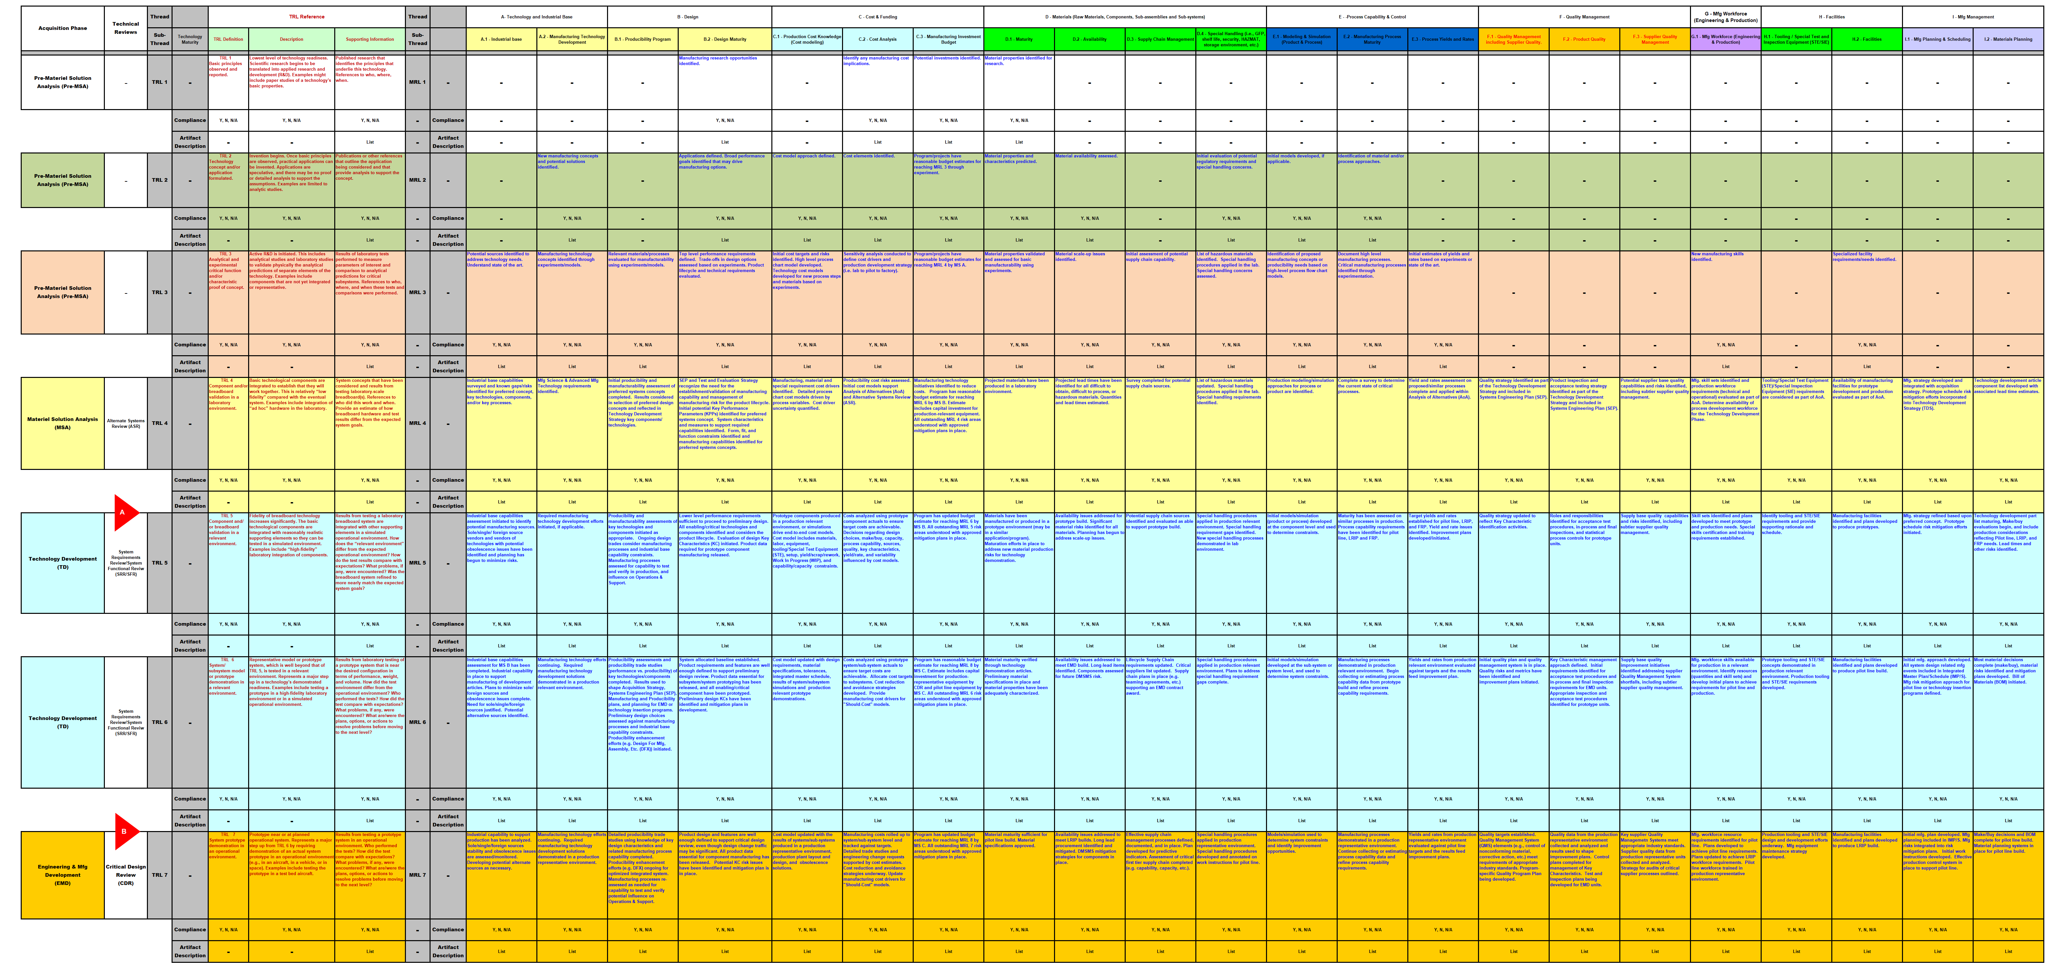
Proposal #:
LIFT Fast Forge
Project #:
Current Technical State
Appendix A

